Slide 1
ARTIFICIAL INTELLIGENCE
Dr. Mohamed Khamiss Hussein
Lecture 2

Slide 2
Missionaries and cannibals
Three missionaries and three cannibals are on the left bank of a river.
There is one canoe which can hold one or two people.
Find a way to get everyone to the right bank, without ever leaving a group of missionaries in one place outnumbered by cannibals in that place.

Slide 3
Missionaries and Cannibals
Initial State

Slide 4
Missionaries and Cannibals
Goal State

Slide 5
Problem Formulation
A Problem Space consists of
The current state of the world (initial state)
A description of the actions we can take to transform one state of the world into another (operators).
A description of the desired state of the world (goal state),
this could be implicit or explicit.
A solution consists of the goal state, or a path to the goal state.

Slide 6
Problem Formulation
States: three numbers (i,j,k) representing the number of missionaries, cannibals, and canoes on the left bank of the river.
Initial state: (3, 3, 1)
Operators: take one missionary, one cannibal, two missionaries, two cannibals, one missionary and one cannibal across the river in a given direction (I.e. ten operators).
Goal Test: reached state (0, 0, 0)
Path Cost: Number of crossings.

Slide 7
Missionaries and Cannibals
(3,3,1): Initial State

Slide 8
Missionaries and Cannibals
A missionary and cannibal cross

Slide 9
Missionaries and Cannibals
(2,2,0)

Slide 10
Missionaries and Cannibals
One missionary returns

Slide 11
Missionaries and Cannibals
(3,2,1)

Slide 12
Missionaries and Cannibals
Two cannibals cross

Slide 13
Missionaries and Cannibals
(3,0,0)

Slide 14
Missionaries and Cannibals
A cannibal returns

Slide 15
Missionaries and Cannibals
(3,1,1)

Slide 16
Missionaries and Cannibals
Two missionaries cross

Slide 17
Missionaries and Cannibals
(1,1,0)

Slide 18
Missionaries and Cannibals
A missionary and cannibal return

Slide 19
Missionaries and Cannibals
(2,2,1)

Slide 20
Missionaries and Cannibals
Two Missionaries cross

Slide 21
Missionaries and Cannibals
(0,2,0)

Slide 22
Missionaries and Cannibals
A cannibal returns

Slide 23
Missionaries and Cannibals
(0,3,1)

Slide 24
Missionaries and Cannibals
Two cannibals cross

Slide 25
Missionaries and Cannibals
(0,1,0)

Slide 26
Missionaries and Cannibals
A cannibal returns

Slide 27
Missionaries and Cannibals
(0,2,1)

Slide 28
Missionaries and Cannibals
The last two cannibals cross

Slide 29
Missionaries and Cannibals
(0,0,0) : Goal State

Slide 30
Missionaries and Cannibals
Solution = the sequence of actions within the path :
[ (3,3,1)→ (2,2,0)→(3,2,1) →(3,0,0) →(3,1,1) →(1,1,0) →(2,2,1) →(0,2,0) →(0,3,1) →(0,1,0) → (0,2,1) →(0,0,0)];
Cost = 11 crossings

Slide 31
Summary
Search: process of constructing sequences of actions that achieve a goal given a problem.
It is assumed that the environment is observable, deterministic, static and completely known.
Goal formulation is the first step in solving problems by searching. It facilitates problem formulation.
Formulating a problem requires specifying five components: State representation, Initial state, Goal state, Operators (actions), and Path cost function.

Slide 32
Problem Solving by Searching Search Methods : Uninformed (Blind) search

Slide 33
The River Problem
The River Problem:
F=Farmer W=Wolf D=Duck C=Corn /=River
How can the farmer safely transport the wolf, the duck and the corn to the opposite shore?
-/FWCD
FWCD/-

Slide 34
The River Problem
Problem Formulation
State representation: location of farmer and items in both sides of river
[items in South shore / items in North shore] : (FWDC/-, FD/WC, C/FWD …)
Initial State: farmer, wolf, duck and corn in the south shore FWDC/-
Goal State: farmer, duck and corn in the north shore -/FWDC
Operators: the farmer takes in the boat at most one item from one side to the other side
(F-Takes-W, F-Takes-D, F-Takes-C, F-Takes-Self [himself only])
Path cost: the number of crossings

Slide 35
The River Problem
Problem solution: (path Cost = 7)
While there are other possibilities here is one 7 step solution to the river problem
F
D
D
F
W
D
F-Takes-D
F-Takes-S
F-Takes-W
F
W
D
C
W
C
F
W
C
C
Initial State
WC/FD
FWC/D
C/FWD
F-Takes-D
F
W
D
C
W
C
F
W
C
W
F-Takes-D
F-Takes-S
F-Takes-C
F
D
D
F
D
C
Goal State
FD/WC
D/FWC
FDC/W

Slide 36
Problem Formulation
Problem formulation:
State representation: location of farmer and items in both sides of river
[items in South shore / items in North shore] : (FWDC/-, FD/WC, C/FWD …)
Initial State: farmer, wolf, duck and corn in the south shore FWDC/-
Goal State: farmer, duck and corn in the north shore
-/FWDC
Operators: the farmer takes in the boat at most one item from one side to the other side
(F-Takes-W, F-Takes-D, F-Takes-C, F-Takes-Self [himself only])
Path cost: the number of crossings

Slide 37
Search Methods
State space:
A problem is solved by moving from the initial state to the goal state by applying valid operators in sequence. Thus the state space is the set of states reachable from a particular initial state.
Initial state
Dead ends
Illegal states
repeated state
intermediate state
Goal state

Slide 38
Search Methods
Searching for a solution:
We start with the initial state and keep using the operators to expand the parent nodes till we find a goal state.
…but the search space might be large…
…really large…
So we need some systematic way to search.

Slide 39
Search Methods
Problem solution:
A problem solution is simply the set of operators (actions) needed to reach the goal state from the initial state:
F-Takes-D, F-Takes-Self, F-Takes-W,
F-Takes-D, F-Takes-C, F-Takes-Self,
F-Takes-D.

Slide 40
Search Methods
Problem solution: (path Cost = 7)
While there are other possibilities here is one 7 step solution to the river problem
F
D
D
F
W
D
F-Takes-D
F-Takes-S
F-Takes-W
F
W
D
C
W
C
F
W
C
C
Initial State
WC/FD
FWC/D
C/FWD
F-Takes-D
F
W
G
C
W
C
F
W
C
W
F-Takes-D
F-Takes-S
F-Takes-C
F
D
D
F
D
C
Goal State
FD/WC
D/FWC
FDC/W

Slide 41
Problem Solving by searching
Basic Search Algorithms

Slide 42
Basic Search Algorithms
uninformed( Blind) search: breadth-first, depth-first, depth limited, iterative deepening, and bidirectional search
informed (Heuristic) search: search is guided by an evaluation function: Greedy best-first, A*, IDA*, and beam search
optimization in which the search is to find an optimal value of an objective function: hill climbing, simulated annealing, genetic algorithms, Ant Colony Optimization
Game playing, an adversarial search: minimax algorithm, alpha-beta pruning

Slide 43
What Criteria are used to Compare different search techniques ?
As we are going to consider different techniques to search the problem space, we need to consider what criteria we will use to compare them.
Completeness: Is the technique guaranteed to find an answer (if there is one).
Optimality/Admissibility : does it always find a least-cost solution?
- an admissible algorithm will find a solution with minimum cost
Time Complexity: How long does it take to find a solution.
Space Complexity: How much memory does it take to find a solution.

Slide 44
Time and Space Complexity ?
Time and space complexity are measured in terms of:
The average number of new nodes we create when expanding a new node is the (effective) branching factor b.
The (maximum) branching factor b is defined as the maximum nodes created when a new node is expanded.
The length of a path to a goal is the depth d.
The maximum length of any path in the state space m.

Slide 45
A Toy Example: A Romanian Holiday
State space: Cities in Romania
Initial state: Town of Arad
Goal: Airport in Bucharest
Operators: Drive between cities
Solution: Sequence of cities
Path cost: number of cities, distance, time, fuel

Slide 46
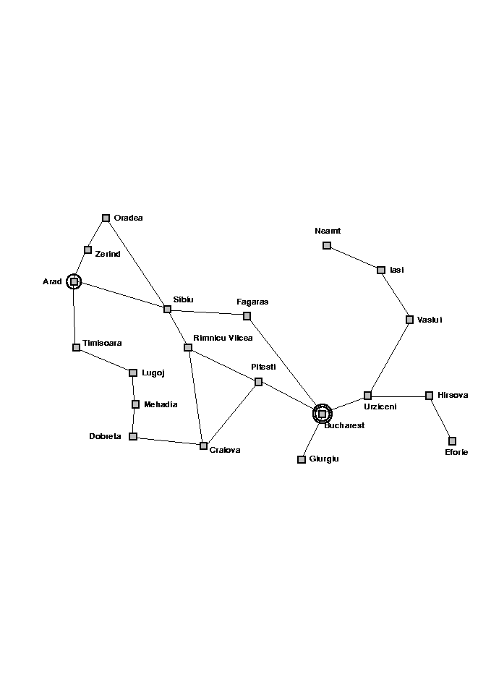
The state Space

Slide 47
Generic Search Algorithms
Basic Idea: Off-line exploration of state space by generating successors of already-explored states (also known as expanding states).
Function GENERAL-SEARCH (problem, strategy)
returns a solution or failure
Initialize the search tree using the initial state of problem
loop do
if there are no candidates for expansion, then return failure
Choose a leaf node for expansion according to strategy
if node contains goal state then return solution
else expand node and add resulting nodes to search tree.
end

Slide 48
Representing Search
Arad
Zerind
Sibiu
Timisoara
Arad
Oradea
Fagaras
Rimnicu Vilcea
Sibiu
Bucharest

Slide 49

Solution

Slide 50
Implementation of Generic Search Algorithm
function general-search(problem, QUEUEING-FUNCTION)
nodes = MAKE-QUEUE(MAKE-NODE(problem.INITIAL-STATE))
loop do
if EMPTY(nodes) then return "failure"
node = REMOVE-FRONT(nodes)
if problem.GOAL-TEST(node.STATE) succeeds then return solution(node)
nodes = QUEUEING-FUNCTION(nodes, EXPAND(node, problem.OPERATORS))
end
A nice fact about this search algorithm is that we can use a single algorithm to do many kinds of search. The only difference is in how the nodes are placed in the queue. The choice of queuing function is the main feature.

Slide 51
Key Issues of State-Space search algorithm
Search process constructs a “search tree”
root is the start node
leaf nodes are:
unexpanded nodes (in the nodes list)
“dead ends” (nodes that aren’t goals and have no successors because no operators were applicable)
Loops in a graph may cause a “search tree” to be infinite even if the state space is small
changing definition of how nodes are added to list leads to a different search strategy
Solution desired may be:
just the goal state
a path from start to goal state (e.g., 8-puzzle)

Slide 52
Uninformed search strategies (Blind search)
Uninformed (blind) strategies use only the information available in the problem definition. These strategies order nodes without using any domain specific information
Contrary to Informed search techniques which might have additional information (e.g. a compass).
Breadth-first search
Uniform-cost search
Depth-first search
Depth-limited search
Iterative deepening search
Bidirectional search

Slide 53
Basic Search Algorithms Uninformed Search
Breadth First Search (BFS)

Slide 54
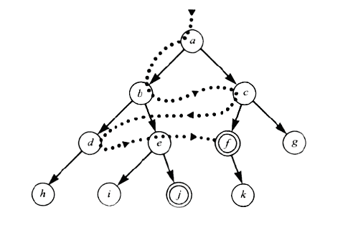
Breadth First Search (BFS)

Slide 55
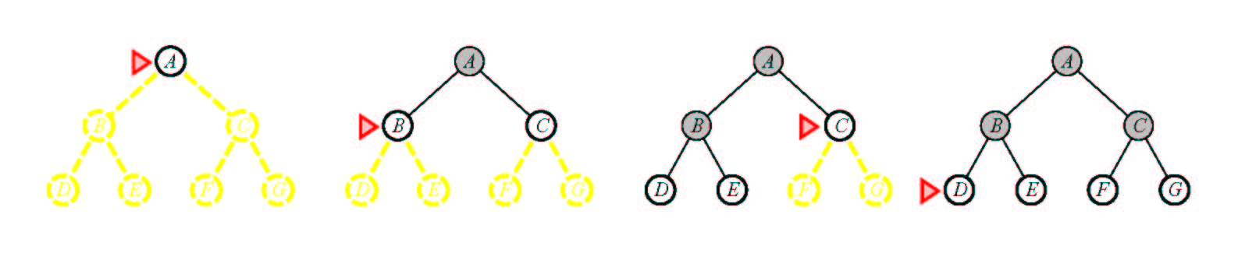
Breadth First Search (BFS)
Main idea: Expand all nodes at depth (i) before expanding nodes at depth (i + 1)
Level-order Traversal.
Implementation: Use of a First-In-First-Out queue (FIFO). Nodes visited first are expanded first. Enqueue nodes in FIFO (first-in, first-out) order.
Complete? Yes.
Optimal? Yes, if path cost is nondecreasing function of depth
Time Complexity: O(b^{d})
Space Complexity: O(b^{d}), note that every node in the fringe is kept in the queue.

Slide 56
Breadth First Search
QUEUING-FN:- successors added to end of queue
Arad
Zerind
Sibiu
Timisoara
Arad
Oradea
Fagaras
Arad
Oradea
Arad
Lugoj
Rimnicu Vilcea
Shallow nodes are expanded before deeper nodes.

Slide 57
Basic Search Algorithms Uninformed Search
Uniform Cost Search (UCS)

Slide 58
Uniform Cost Search (UCS)
5
2
[5]
[2]
1
4
1
7
[6]
[3]
[9]
[9]
Goal state
4
5
[x] = g(n)
path cost of node n
[7]
[8]

Slide 59
Uniform Cost Search (UCS)
5
2
[5]
[2]

Slide 60
Uniform Cost Search (UCS)
5
2
[5]
[2]
1
7
[3]
[9]

Slide 61
Uniform Cost Search (UCS)
5
2
[5]
[2]
1
7
[3]
[9]
4
5
[7]
[8]

Slide 62
Uniform Cost Search (UCS)
5
2
[5]
[2]
1
4
1
7
[6]
[3]
[9]
[9]
4
5
[7]
[8]

Slide 63
Uniform Cost Search (UCS)
5
2
[5]
[2]
Goal state path cost g(n)=[6]
1
4
1
7
[3]
[9]
[9]
4
5
[7]
[8]

Slide 64
Uniform Cost Search (UCS)
5
2
[5]
[2]
1
4
1
7
[6]
[3]
[9]
[9]
4
5
[7]
[8]

Slide 65
Uniform Cost Search (UCS)
In case of equal step costs, Breadth First search finds the optimal solution.
For any step-cost function, Uniform Cost search expands the node n with the lowest path cost.
UCS takes into account the total cost: g(n).
UCS is guided by path costs rather than depths. Nodes are ordered according to their path cost.

Slide 66
Uniform Cost Search (UCS)
Main idea: Expand the cheapest node. Where the cost is the path cost g(n).
Implementation:
Enqueue nodes in order of cost g(n).
QUEUING-FN:- insert in order of increasing path cost.
Enqueue new node at the appropriate position in the queue so that we dequeue the cheapest node.
Complete? Yes.
Optimal? Yes, if path cost is nondecreasing function of depth
Time Complexity: O(b^{d})
Space Complexity: O(b^{d}), note that every node in the fringe keep in the queue.

Slide 67
Basic Search Algorithms Uninformed Search
Depth First Search (DFS)

Slide 68
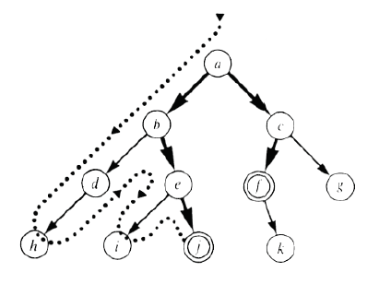
Depth First Search (DFS)

Slide 69
Depth First Search (DFS)
Main idea: Expand node at the deepest level (breaking ties left to right).
Implementation: use of a Last-In-First-Out queue or stack(LIFO). Enqueue nodes in LIFO (last-in, first-out) order.
Complete? No (Yes on finite trees, with no loops).
Optimal? No
Time Complexity: O(b^{m}), where m is the maximum depth.
Space Complexity: O(bm), where m is the maximum depth.

Slide 70
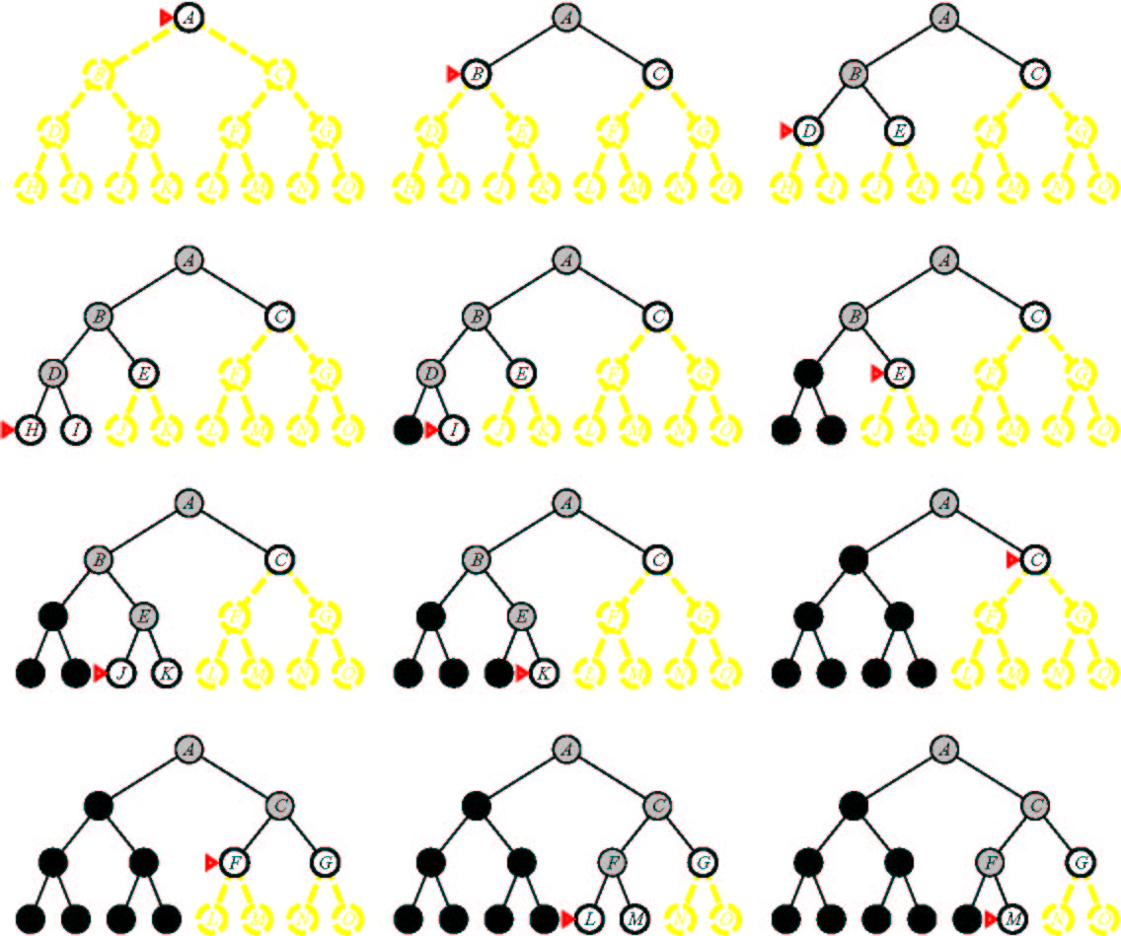
Depth First Search

Slide 71
Depth-First Search (DFS)
QUEUING-FN:- insert successors at front of queue
Arad
Zerind
Sibiu
Timisoara
Arad
Oradea
Zerind
Sibiu
Timisoara

Slide 72
Basic Search Algorithms Uninformed Search
Depth-Limited Search (DLS)

Slide 73

Depth-Limited Search (DLS)
Depth Bound = 3

Slide 74
Depth-Limited Search (DLS)
It is simply DFS with a depth bound.
Searching is not permitted beyond the depth bound.
Works well if we know what the depth of the solution is.
Termination is guaranteed.
If the solution is beneath the depth bound, the search cannot find the goal (hence this search algorithm is incomplete).
Otherwise use Iterative deepening search (IDS).

Slide 75
Depth-Limited Search (DLS)
Main idea: Expand node at the deepest level, but limit depth to L.
Implementation:
Enqueue nodes in LIFO (last-in, first-out) order. But limit depth to L
Complete? Yes if there is a goal state at a depth less than L
Optimal? No
Time Complexity: O(b^{L}), where L is the cutoff.
Space Complexity: O(bL), where L is the cutoff.

Slide 76
Basic Search Algorithms Uninformed Search
Iterative Deepening Search (IDS)

Slide 77
Iterative Deepening Search (IDS)
function ITERATIVE-DEEPENING-SEARCH():
for depth = 0 to infinity do
if DEPTH-LIMITED-SEARCH(depth) succeeds
then return its result
end
return failure

Slide 78
Iterative Deepening Search (IDS)
Key idea: Iterative deepening search (IDS) applies DLS repeatedly with increasing depth. It terminates when a solution is found or no solutions exists.
IDS combines the benefits of BFS and DFS: Like DFS the memory requirements are very modest (O(bd)). Like BFS, it is complete when the branching factor is finite.
The total number of generated nodes is :
N(IDS)=(d)b + (d-1) b² + …+(1)b^{d}
In general, iterative deepening is the preferred uninformed search method when there is a large search space and the depth of the solution is not known.

Slide 79
Iterative Deepening Search (IDS)
L = 0
L = 1
L = 2
L = 3

Slide 80
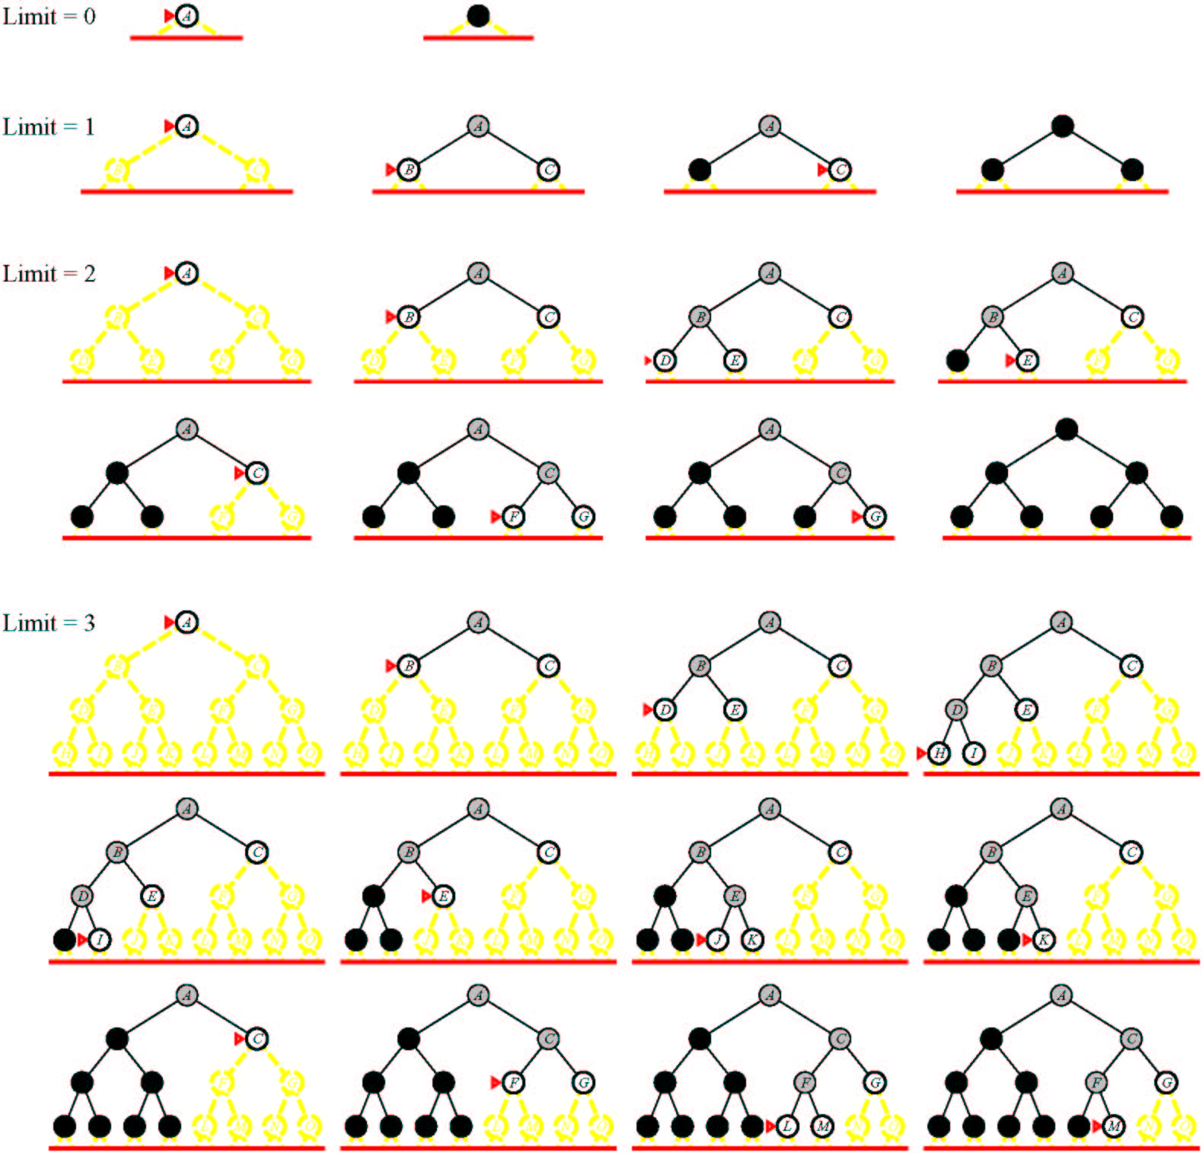
Iterative Deepening Search (IDS)

Slide 81
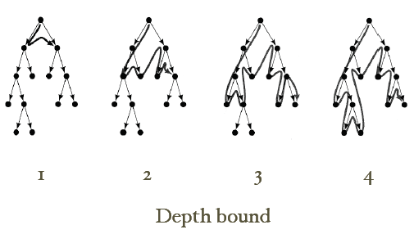
Iterative Deepening Search (IDS)

Slide 82
Basic Search Algorithms Uninformed Search
Bi-Directional Search (BDS)

Slide 83
Bi-directional Search (BDS)
Main idea: Start searching from both the initial state and the goal state, meet in the middle.
Complete? Yes
Optimal? Yes
Time Complexity: O(b^{d/2}), where d is the depth of the solution.
Space Complexity: O(b^{d/2}), where d is the depth of the solution.

Slide 84
Basic Search Algorithms
Comparison of search algorithms

Slide 85
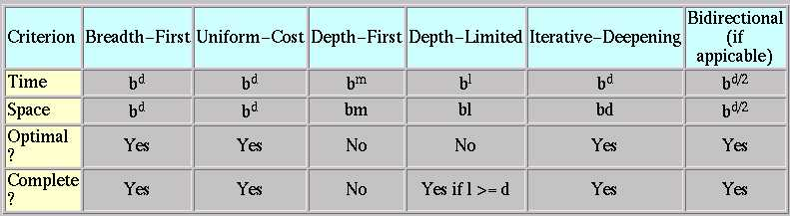
Comparison of search algorithms
b: Branching factor
d: Depth of solution
m: Maximum depth
l : Depth Limit

Slide 86
Blind Search Algorithms
Tree Search:
BFS, DFS, DLS, IDS

Slide 87
Basic Search Algorithms
Breadth First Search
BFS

Slide 88
Breadth First Search
Application1:
Given the following state space (tree search), give the sequence of visited nodes when using BFS (assume that the nodeO is the goal state):
A
B
C
D
E
F
G
H
I
J
K
L
M
N
O

Slide 89
Breadth First Search
A,
A
B
C
D
E

Slide 90
Breadth First Search
A,
B,
A
B
C
D
E
F
G

Slide 91
Breadth First Search
A,
B,C
A
B
C
D
E
F
G
H

Slide 92
Breadth First Search
A,
B,C,D
A
B
C
D
E
F
G
H
I
J

Slide 93
Breadth First Search
A,
B,C,D,E
A
B
C
D
E
F
G
H
I
J

Slide 94
Breadth First Search
A,
B,C,D,E,
F,
A
B
C
D
E
F
G
H
I
J

Slide 95
Breadth First Search
A,
B,C,D,E,
F,G
A
B
C
D
E
F
G
H
I
J
K
L

Slide 96
Breadth First Search
A,
B,C,D,E,
F,G,H
A
B
C
D
E
F
G
H
I
J
K
L

Slide 97
Breadth First Search
A,
B,C,D,E,
F,G,H,I
A
B
C
D
E
F
G
H
I
J
K
L
M

Slide 98
Breadth First Search
A,
B,C,D,E,
F,G,H,I,J,
A
B
C
D
E
F
G
H
I
J
K
L
M
N

Slide 99
Breadth First Search
A,
B,C,D,E,
F,G,H,I,J,
K,
A
B
C
D
E
F
G
H
I
J
K
L
M
N

Slide 100
Breadth First Search
A,
B,C,D,E,
F,G,H,I,J,
K,L
A
B
C
D
E
F
G
H
I
J
K
L
M
N
O

Slide 101
Breadth First Search
A,
B,C,D,E,
F,G,H,I,J,
K,L, M,
A
B
C
D
E
F
G
H
I
J
K
L
M
N
O

Slide 102
Breadth First Search
A,
B,C,D,E,
F,G,H,I,J,
K,L, M,N,
A
B
C
D
E
F
G
H
I
J
K
L
M
N
O

Slide 103
Breadth First Search
A,
B,C,D,E,
F,G,H,I,J,
K,L, M,N,
Goal state: O
A
B
C
D
E
F
G
H
I
J
K
L
M
N
O

Slide 104
Breadth First Search
The returned solution is the sequence of operators in the path:
A, B, G, L, O
A
B
C
D
E
F
G
H
I
J
K
L
M
N
O

Slide 105
Basic Search Algorithms
Depth First Search
DFS

Slide 106
Depth First Search (DFS)
Application2:
Given the following state space (tree search), give the sequence of visited nodes when using DFS (assume that the nodeO is the goal state):
A
B
C
D
E
F
G
H
I
J
K
L
M
N
O

Slide 107
Depth First Search
A,
A
B
C
D
E

Slide 108
Depth First Search
A,B,
A
B
C
D
E
F
G

Slide 109
Depth First Search
A,B,F,
A
B
C
D
E
F
G

Slide 110
Depth First Search
A,B,F,
G,
A
B
C
D
E
F
G
K
L

Slide 111
Depth First Search
A,B,F,
G,K,
A
B
C
D
E
F
G
K
L

Slide 112
Depth First Search
A,B,F,
G,K,
L,
A
B
C
D
E
F
G
K
L
O

Slide 113
Depth First Search
A,B,F,
G,K,
L, O: Goal State
A
B
C
D
E
F
G
K
L
O

Slide 114
Depth First Search
The returned solution is the sequence of operators in the path: A, B, G, L, O
A
B
C
D
E
F
G
K
L
O

Slide 115
Basic Search Algorithms
Depth-Limited Search
DLS

Slide 116
Depth-Limited Search (DLS)
Application3:
Given the following state space (tree search), give the sequence of visited nodes when using DLS (Limit = 2):
Limit = 0
A
Limit = 1
B
C
D
E
Limit = 2
F
G
H
I
J
K
L
M
N
O

Slide 117
Depth-Limited Search (DLS)
A,
A
B
C
D
E
Limit = 2

Slide 118
Depth-Limited Search (DLS)
A,B,
A
B
C
D
E
Limit = 2
F
G

Slide 119
Depth-Limited Search (DLS)
A,B,F,
A
B
C
D
E
Limit = 2
F
G

Slide 120
Depth-Limited Search (DLS)
A,B,F,
G,
A
B
C
D
E
Limit = 2
F
G

Slide 121
Depth-Limited Search (DLS)
A,B,F,
G,
C,
A
B
C
D
E
Limit = 2
F
G
H

Slide 122
Depth-Limited Search (DLS)
A,B,F,
G,
C,H,
A
B
C
D
E
Limit = 2
F
G
H

Slide 123
Depth-Limited Search (DLS)
A,B,F,
G,
C,H,
D,
A
B
C
D
E
Limit = 2
F
G
H
I
J

Slide 124
Depth-Limited Search (DLS)
A,B,F,
G,
C,H,
D,I
A
B
C
D
E
Limit = 2
F
G
H
I
J

Slide 125
Depth-Limited Search (DLS)
A,B,F,
G,
C,H,
D,I
J,
A
B
C
D
E
Limit = 2
F
G
H
I
J

Slide 126
Depth-Limited Search (DLS)
A,B,F,
G,
C,H,
D,I
J,
E
A
B
C
D
E
Limit = 2
F
G
H
I
J

Slide 127
Depth-Limited Search (DLS)
A,B,F,
G,
C,H,
D,I
J,
E, Failure
A
B
C
D
E
Limit = 2
F
G
H
I
J

Slide 128
Depth-Limited Search (DLS)
DLS algorithm returns Failure (no solution)
The reason is that the goal is beyond the limit (Limit =2): the goal depth is (d=4)
A
B
C
D
E
Limit = 2
F
G
H
I
J
K
L
M
N
O

Slide 129
Basic Search Algorithms
Iterative Deepening Search
IDS

Slide 130
Iterative Deepening Search (IDS)
Application4:
Given the following state space (tree search), give the sequence of visited nodes when using IDS:
Limit = 0
A
Limit = 1
B
C
D
E
Limit = 2
F
G
H
I
J
Limit = 3
K
L
M
N
Limit = 4
O

Slide 131
Iterative Deepening Search (IDS)
DLS with bound = 0

Slide 132
Iterative Deepening Search (IDS)
A,
Limit = 0
A

Slide 133
Iterative Deepening Search (IDS)
A, Failure
Limit = 0
A

Slide 134
Iterative Deepening Search (IDS)
DLS with bound = 1

Slide 135
Iterative Deepening Search (IDS)
A,
A
Limit = 1
B
C
D
E

Slide 136
Iterative Deepening Search (IDS)
A,B,
A
Limit = 1
B
C
D
E

Slide 137
Iterative Deepening Search (IDS)
A,B,
C,
A
Limit = 1
B
C
D
E

Slide 138
Iterative Deepening Search (IDS)
A,B,
C,
D,
A
Limit = 1
B
C
D
E

Slide 139
Iterative Deepening Search (IDS)
A,B
C,
D,
E,
A
Limit = 1
B
C
D
E

Slide 140
Iterative Deepening Search (IDS)
A,B,
C,
D,
E, Failure
A
Limit = 1
B
C
D
E

Slide 141
Iterative Deepening Search (IDS)
A,
A
B
C
D
E
Limit = 2

Slide 142
Iterative Deepening Search (IDS)
A,B,
A
B
C
D
E
Limit = 2
F
G

Slide 143
Iterative Deepening Search (IDS)
A,B,F,
A
B
C
D
E
Limit = 2
F
G

Slide 144
Iterative Deepening Search (IDS)
A,B,F,
G,
A
B
C
D
E
Limit = 2
F
G

Slide 145
Iterative Deepening Search (IDS)
A,B,F,
G,
C,
A
B
C
D
E
Limit = 2
F
G
H

Slide 146
Iterative Deepening Search (IDS)
A,B,F,
G,
C,H,
A
B
C
D
E
Limit = 2
F
G
H

Slide 147
Iterative Deepening Search (IDS)
A,B,F,
G,
C,H,
D,
A
B
C
D
E
Limit = 2
F
G
H
I
J

Slide 148
Iterative Deepening Search (IDS)
A,B,F,
G,
C,H,
D,I
A
B
C
D
E
Limit = 2
F
G
H
I
J

Slide 149
Iterative Deepening Search (IDS)
A,B,F,
G,
C,H,
D,I
J,
A
B
C
D
E
Limit = 2
F
G
H
I
J

Slide 150
Iterative Deepening Search (IDS)
A,B,F,
G,
C,H,
D,I
J,
E
A
B
C
D
E
Limit = 2
F
G
H
I
J

Slide 151
Iterative Deepening Search (IDS)
A,B,F,
G,
C,H,
D,I
J,
E, Failure
A
B
C
D
E
Limit = 2
F
G
H
I
J
K
L
M
N
O

Slide 152
Iterative Deepening Search (IDS)
DLS with bound = 3

Slide 153
Iterative Deepening Search (IDS)
A,
A
B
C
D
E
Limit = 3

Slide 154
Iterative Deepening Search (IDS)
A,B,
A
B
C
D
E
F
G
Limit = 3

Slide 155
Iterative Deepening Search (IDS)
A,B,F,
A
B
C
D
E
F
G
Limit = 3

Slide 156
Iterative Deepening Search (IDS)
A,B,F,
G,
A
B
C
D
E
F
G
Limit = 3
K
L

Slide 157
Iterative Deepening Search (IDS)
A,B,F,
G,K,
A
B
C
D
E
F
G
Limit = 3
K
L

Slide 158
Iterative Deepening Search (IDS)
A,B,F,
G,K,
L,
A
B
C
D
E
F
G
Limit = 3
K
L

Slide 159
Iterative Deepening Search (IDS)
A,B,F,
G,K,
L,
C,
A
B
C
D
E
F
G
H
Limit = 3
K
L

Slide 160
Iterative Deepening Search (IDS)
A,B,F,
G,K,
L,
C,H,
A
B
C
D
E
F
G
H
Limit = 3
K
L

Slide 161
Iterative Deepening Search (IDS)
A,B,F,
G,K,
L,
C,H,
D,
A
B
C
D
E
F
G
H
I
J
Limit = 3
K
L

Slide 162
Iterative Deepening Search (IDS)
A,B,F,
G,K,
L,
C,H,
D,I,
A
B
C
D
E
F
G
H
I
J
Limit = 3
K
L
M

Slide 163
Iterative Deepening Search (IDS)
A,B,F,
G,K,
L,
C,H,
D,I,M,
A
B
C
D
E
F
G
H
I
J
Limit = 3
K
L
M

Slide 164
Iterative Deepening Search (IDS)
A,B,F,
G,K,
L,
C,H,
D,I,M,
J,
A
B
C
D
E
F
G
H
I
J
Limit = 3
K
L
M
N

Slide 165
Iterative Deepening Search (IDS)
A,B,F,
G,K,
L,
C,H,
D,I,M,
J,N,
A
B
C
D
E
F
G
H
I
J
Limit = 3
K
L
M
N

Slide 166
Iterative Deepening Search (IDS)
A,B,F,
G,K,
L,
C,H,
D,I,M,
J,N,
E,
A
B
C
D
E
F
G
H
I
J
Limit = 3
K
L
M
N

Slide 167
Iterative Deepening Search (IDS)
A,B,F,
G,K,
L,
C,H,
D,I,M,
J,N,
E,Failure
A
B
C
D
E
F
G
H
I
J
Limit = 3
K
L
M
N
O

Slide 168
Iterative Deepening Search (IDS)
DLS with bound = 4

Slide 169
Iterative Deepening Search (IDS)
A,
A
B
C
D
E
Limit = 4

Slide 170
Iterative Deepening Search (IDS)
A,B,
A
B
C
D
E
F
G
Limit = 4

Slide 171
Iterative Deepening Search (IDS)
A,B,F,
A
B
C
D
E
F
G
Limit = 4

Slide 172
Iterative Deepening Search (IDS)
A,B,F,
G,
A
B
C
D
E
F
G
K
L
Limit = 4

Slide 173
Iterative Deepening Search (IDS)
A,B,F,
G,K,
A
B
C
D
E
F
G
K
L
Limit = 4

Slide 174
Iterative Deepening Search (IDS)
A,B,F,
G,K,
L,
A
B
C
D
E
F
G
K
L
Limit = 4
O

Slide 175
Iterative Deepening Search (IDS)
A,B,F,
G,K,
L, O: Goal State
A
B
C
D
E
F
G
K
L
Limit = 4
O

Slide 176
Iterative Deepening Search (IDS)
The returned solution is the sequence of operators in the path: A, B, G, L, O
A
B
C
D
E
F
G
K
L
O

Slide 177
Summary
Search: process of constructing sequences of actions that achieve a goal given a problem.
The studied methods assume that the environment is observable, deterministic, static and completely known.
Goal formulation is the first step in solving problems by searching. It facilitates problem formulation.
Formulating a problem requires specifying four components: Initial states, operators, goal test and path cost function. Environment is represented as a state space.
A solution is a path from the initial state to a goal state.
Search algorithms are judged on the basis of completeness, optimality, time complexity and space complexity.
Several search strategies: BFS, DFS, DLS, IDS,…
All uninformed searches have an exponential time complexity – hopeless as a viable problem solving mechanism (unless you have a quantum computer!)

Slide 178
Thank you

